Slide 1
EITC Training Workshop

Slide 2
EITC Pre-K Funds Provided By

Slide 3
EITC K-12 Funds Provided By

Slide 4
Information to Remember
March 17, 2025-Online Application Opens
July 15, 2025-Online Application Closes
Curriculum Alignment Letters needed for all schools with a Pre-K Program
Due by April 1, 2025
Each student needs to have their own application

Slide 5
How to Apply
https://www.grantinterface.com/Home/Logon?urlkey=servingtheheart
Visit www.servingtheheart.org- →select Tuition Assistance from the Menu→Select How to Apply on the left side of the screen→There will be an Apply Now button to select that will take you to the login screen.
You will need to create an account if you have not already done so.

Slide 6
Once logged into your account select Apply at the top of the screen.
All open applications will be displayed.
Please note there are separate applications for Pre-K and K-12
and a separate application needs completed for each child.

Slide 7
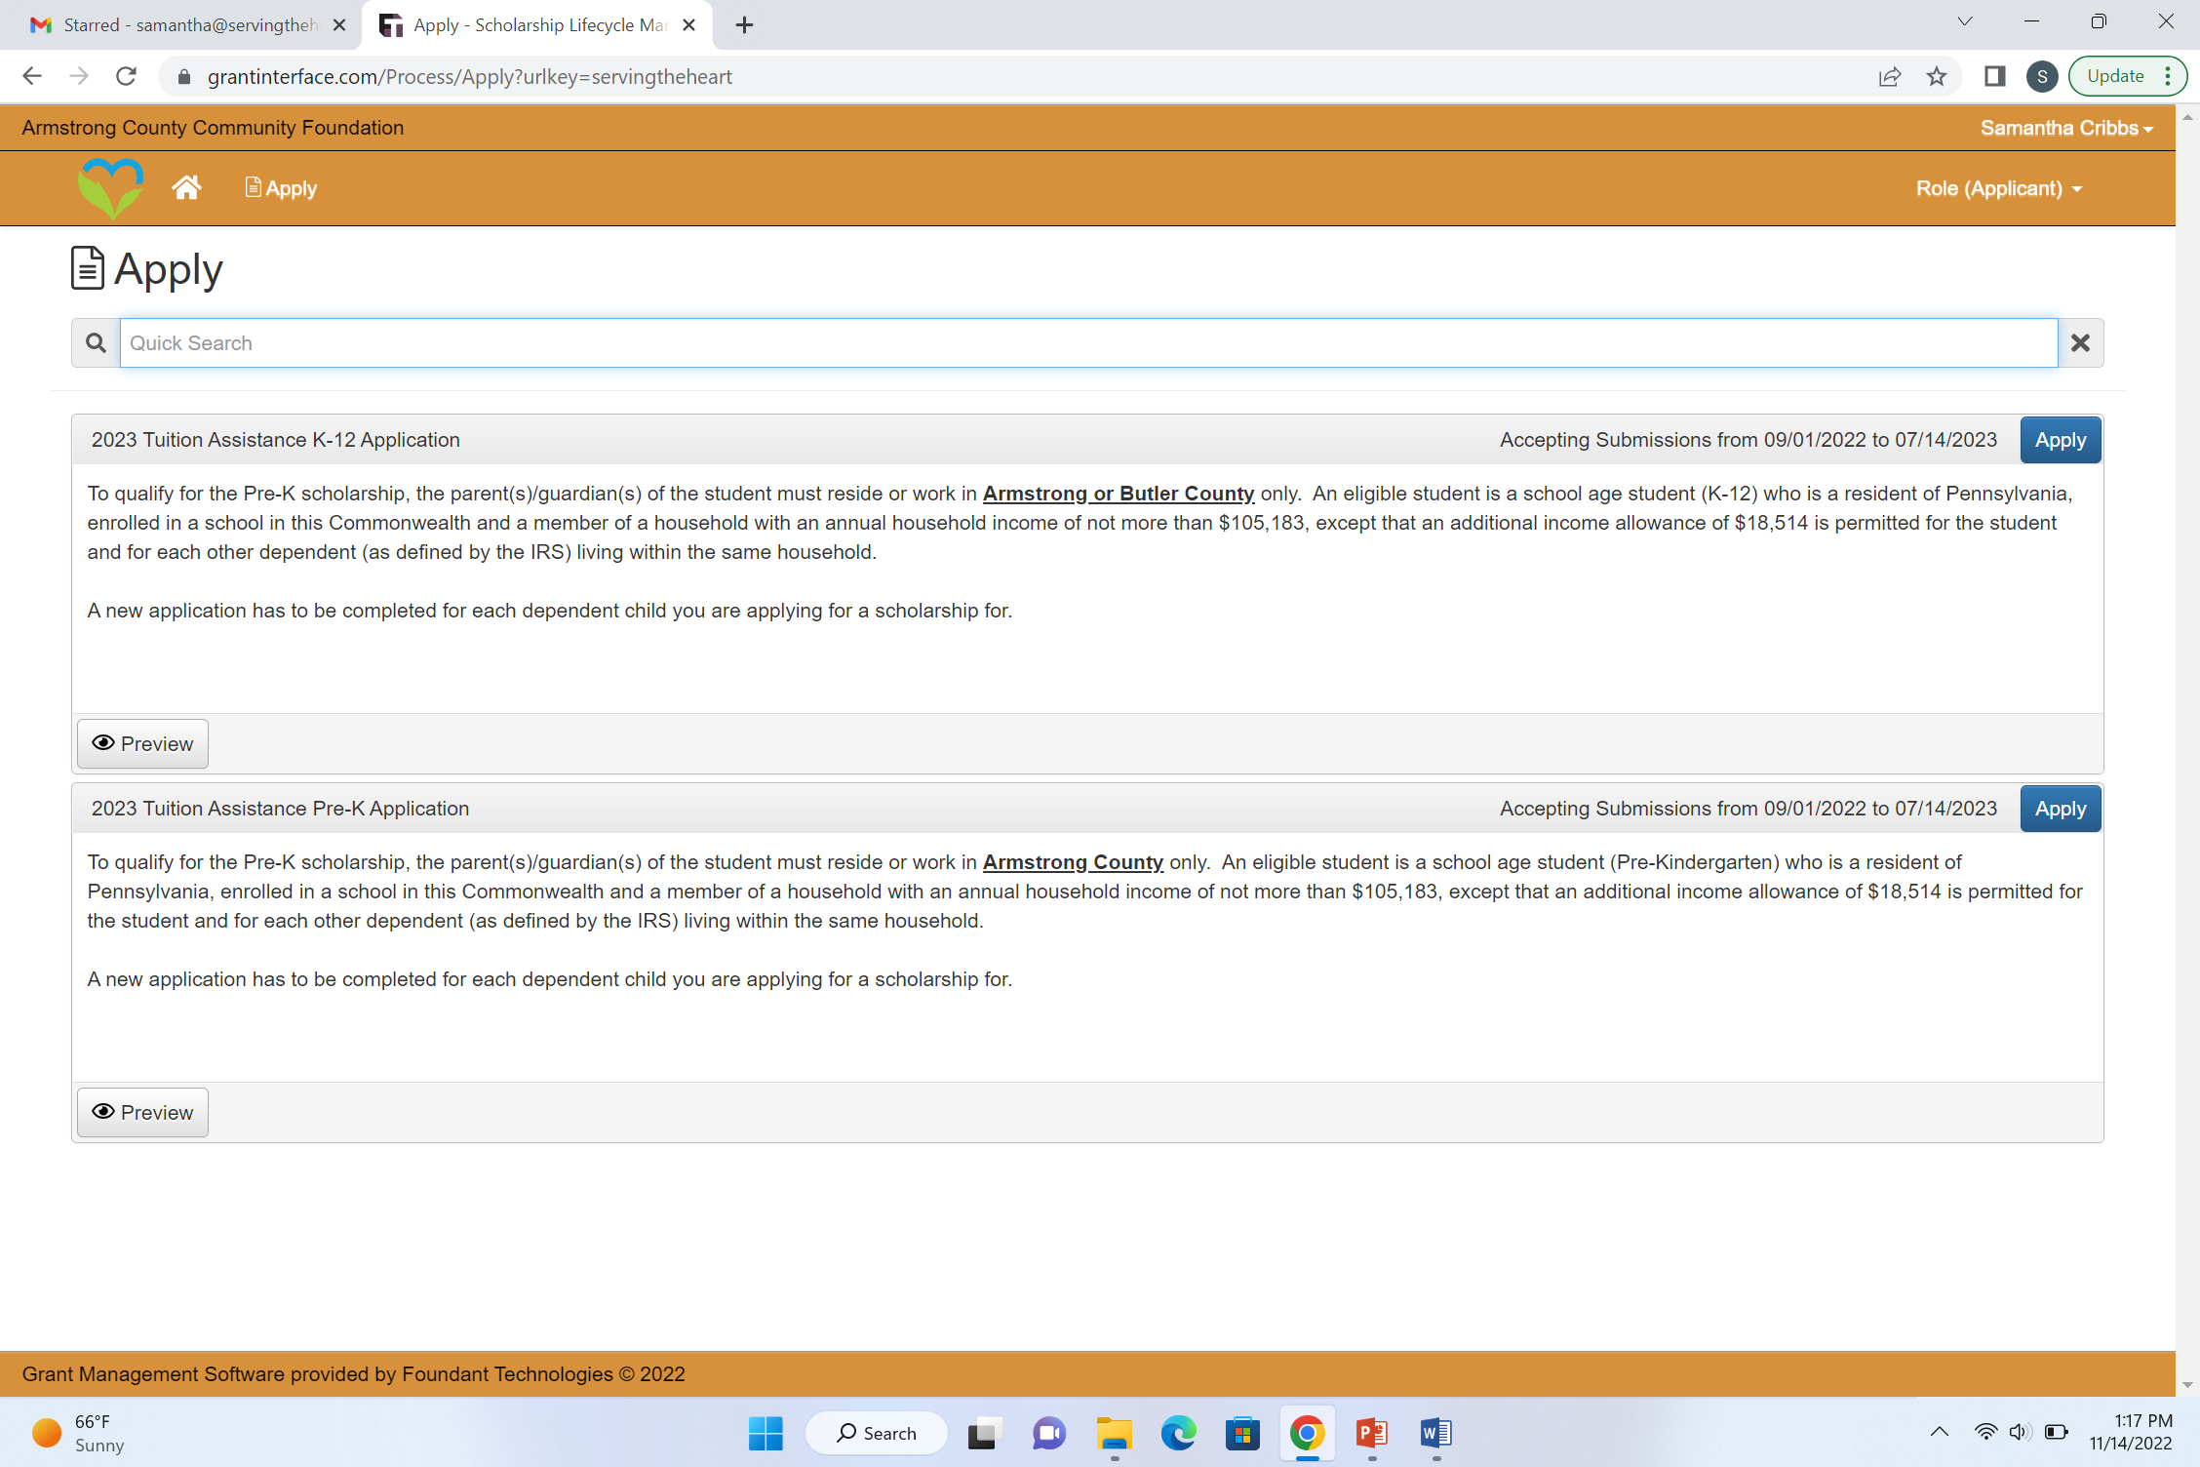
Please note there are separate applications for Pre-K and K-12 and a separate application needs completed for each child
Select Apply on the application you need for your child
OR

Slide 8
The Below Screen will appear after you have selected apply.

Slide 9
5 Application Sections
APPLICATION
CONTACT INFORMATION
RESIDENCY REQUIREMENT QUESTIONS-May also need to complete other County of Residence Section
INCOME REQUIREMENT QUESTIONS
ELECTRONIC SIGNATURES

Slide 10
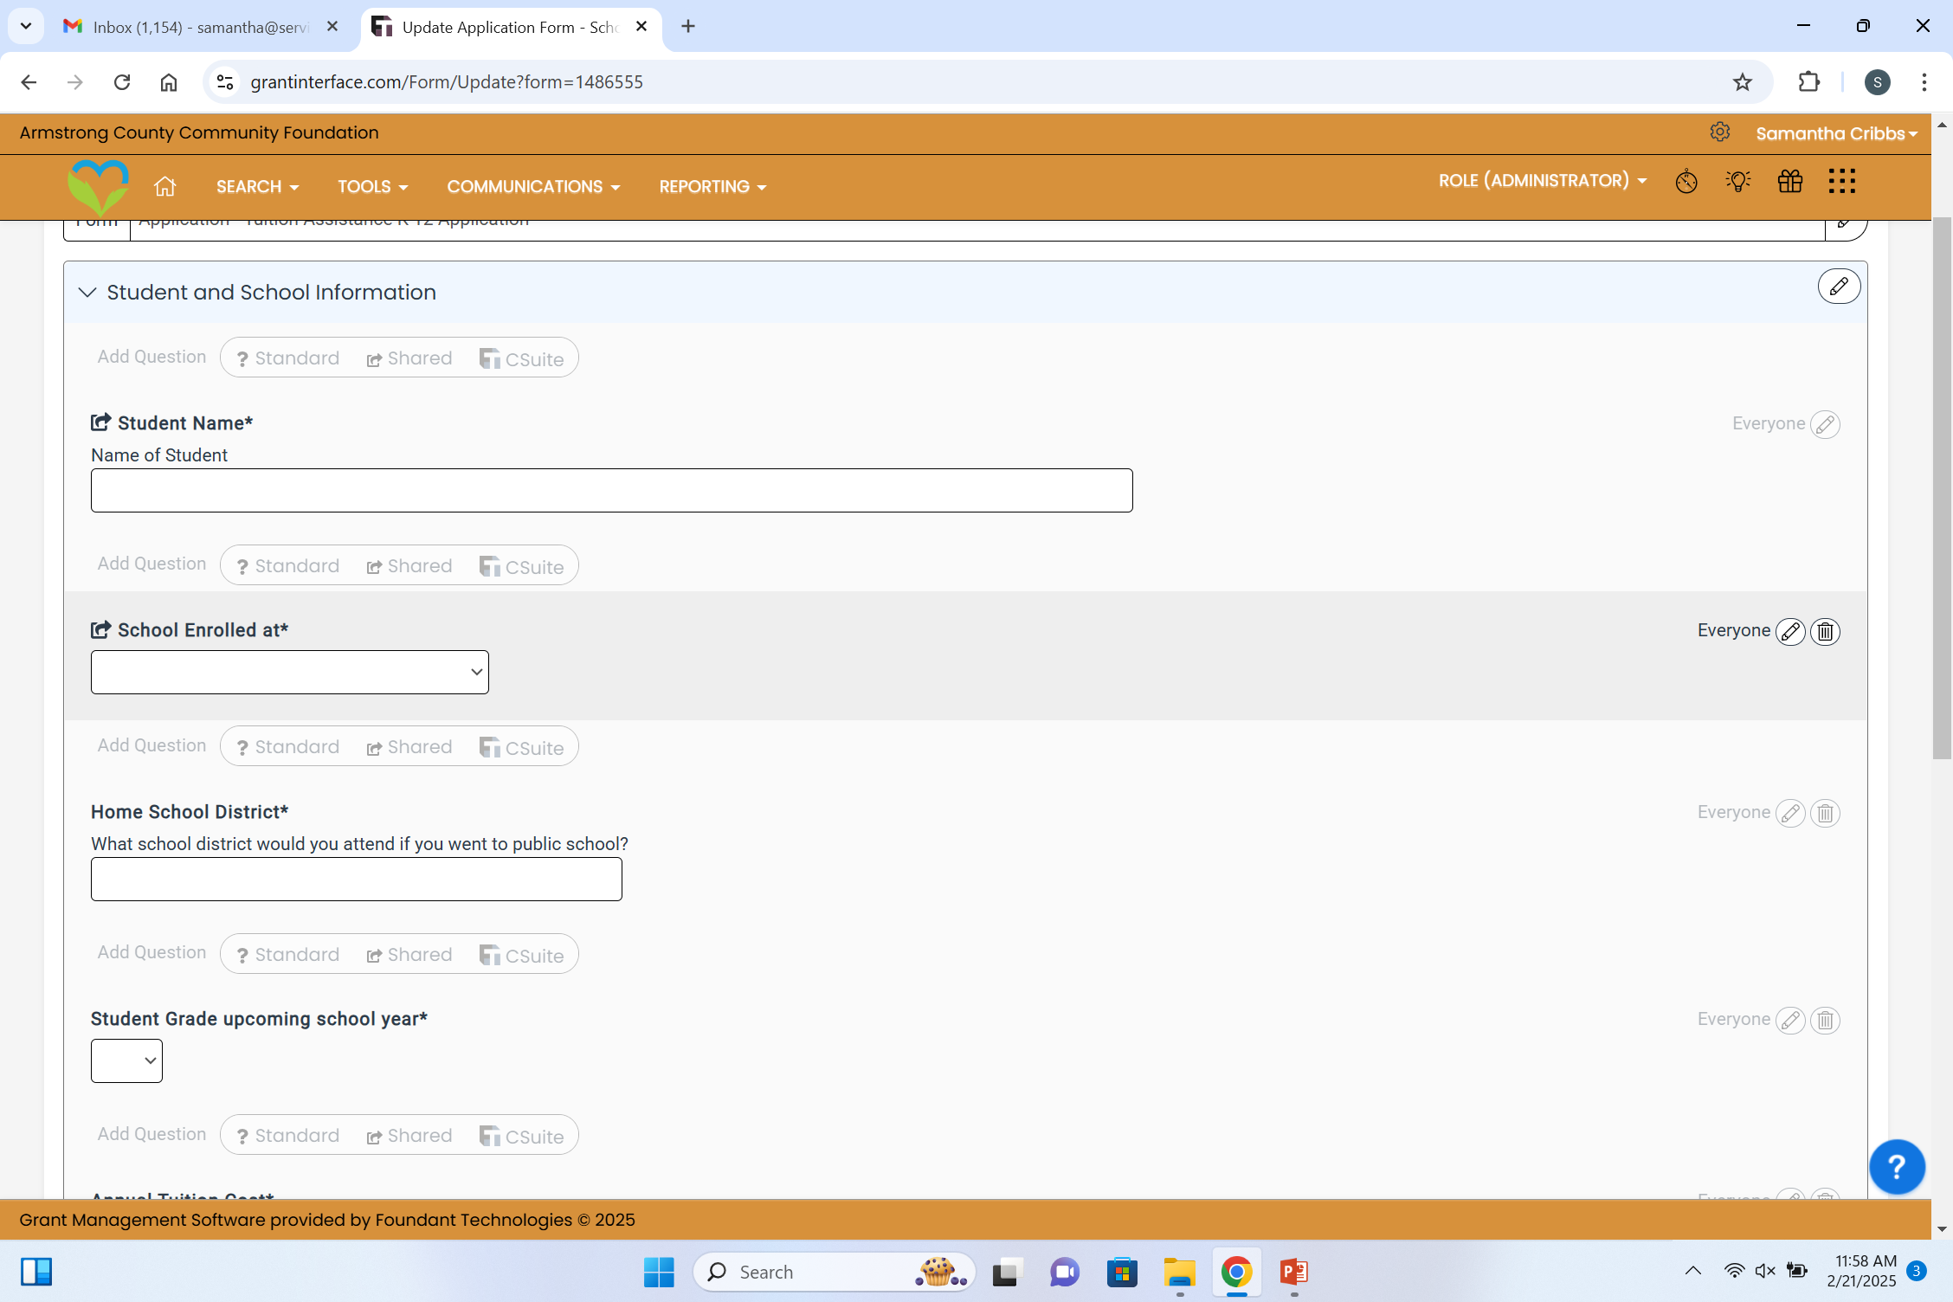
Application Section
Student Name
School Enrolled at
Home School District (K-12 Applications)
Student Grade (upcoming school year)
Tuition Cost (annual)

Slide 11
Contact Information Section
Parent(s) First Name
Parent(s) Last Name
Home Address
Mailing Address (if different than home address)
City
State
Zip Code
Primary Phone Number
Alternate Phone Number
Email Address

Slide 12
Residency Section
Select County of Residence
If you select “other” more questions will appear
To qualify for the Pre-K scholarship, the parent(s)/guardian(s) of the student must reside or work in Armstrong County only.
To qualify for the K-12 scholarship, the parent(s)/guardian(s) of the student must reside or work in Armstrong or Butler County.

Slide 13
Income Section
Number of Dependents Claimed on Tax Return
Adjusted Gross Income
UPLOAD Page 1 Federal Income Tax Return 1040
UPLOAD Additional File Space
UPLOAD and document any change in financial status from the prior years tax return until the date submitted

Slide 14
Electronic Signature Section
Enter your full name to acknowledge that the information you provided is accurate and true to the best of your knowledge. Also, to acknowledge that you understand all communication relating to this application will be done via email and through the online portal you are using to apply.
Once complete, select the Submit Application button at the end of the application. Your application will be listed in a “draft” status until the Submit Application button is selected. Any application in a draft status at the application deadline will not be considered for tuition assistance.

Slide 15
Applying for Multiple Students If you have multiple students when you go to start the next students application in the upper right hand corner there is a button that says Copy Previous Answers

Slide 16
A screen will appear allowing you to select the Process (Application) you would like to copy.

Slide 17
A prompt will appear asking you to Confirm Copying Answers. Please read the prompt carefully and select OK if you agree.

Slide 18
A new application will now appear and you will need to change any information that is different from your previous application.
Once complete, select the Submit Application button at the end of the application. Your application will be listed in a “draft” status until the Submit Application button is selected. Any application in a draft status at the application deadline will not be considered for tuition assistance.

Slide 19
ITEMS TO CONSIDER WHEN COMPLETING APPLICATION
Once you start an application you can save the application and return to complete it later.
Page 1 of your 1040 tax return and/or proof of income or change in financial status must be attached for consideration.
You may black out any sensitive information on the 1040 including social security numbers and banking information.
All communication will be through the online portal and/or email regarding your student’s tuition assistance.
Emails will come from Armstrong County Community Foundation (administrator@grantinterface.com THIS IS A NO REPLY EMAIL ADDRESS) If you select reply the email will come directly to samantha@servingtheheart.org. Please check your spam/trash folder to make sure messages are not automatically placed there.
Contact your school for assistance in completing the form if needed

Slide 20
THANK YOU!

